Slide 1
CSE322
Formal Languages and Regular Grammar
Lecture #13
School of Computer Science and Engineering

Slide 2
Formal Language
A formal language L is a set of finite-length words (or "strings") over some finite alphabet A. ε is the empty word.
Example:
A = {a, b, c}
L₁ = {ab, c}

Slide 3
Formal Grammar - Definition
A formal grammar G = (N, Σ, P, S) consists of:
A finite set N of nonterminal symbols.
A finite set Σ of terminal symbols that is disjoint from N.
A finite set P of production rules where a rule is of the form
    string in (Σ U N)*
    (where * is the Kleene star and U is set union)
  the left-hand side of a rule must contain at least one nonterminal symbol.
A symbol S in N that is indicated as the start symbol.

Slide 4
Language of a Formal Grammar
The language of a formal grammar G = (N, Σ, P, S), denoted as L(G), is defined as all those strings over Σ that can be generated by starting with the start symbol S and then applying the production rules in P until no more nonterminal symbols are present.

Slide 5
Language of a Formal Grammar
Example
Consider, for example, the grammar G with N = {S, B}, Σ = {a, b, c}, P consisting of the following production rules
  1. S -> aBSc
  2. S -> abc
  3. Ba -> aB
  4. Bb -> bb
This grammar defines the language {a^{n}b^{n}c^{n} | n>0}

Slide 6
MCQ
The Grammar can be defined as: G=(N, ∑, P, S)
In the given definition, what does S represents?
a) Accepting State
b) Starting Variable
c) Sensitive Grammar
d) None of these

Slide 7
MCQ
. The entity which generate Language is termed as:
a) Automata
b) Tokens
c) Grammar
d) Data

Slide 8
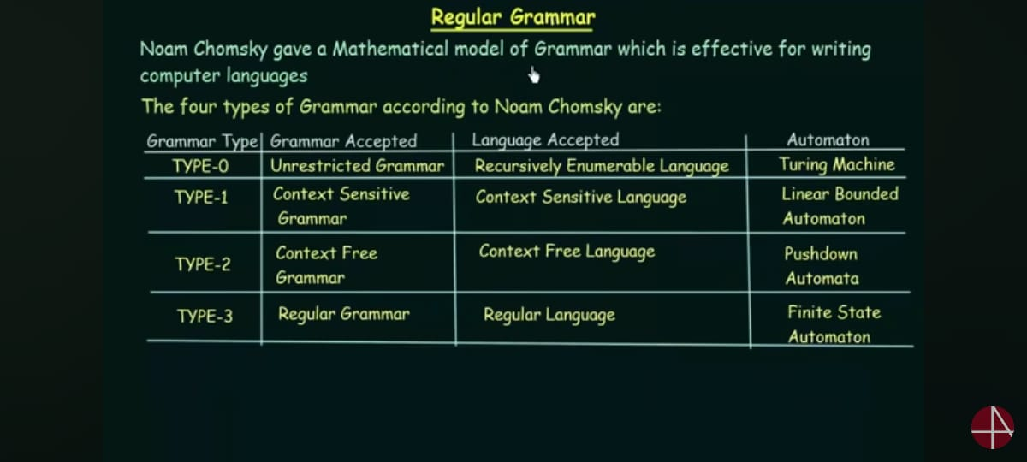

Slide 9
Chomsky Classification
Chomsky Classification represents the class of languages that are accepted by the different machine. The category of language in Chomsky's Classification is as given below:
Type 0 known as Unrestricted Grammar.
Type 1 known as Context Sensitive Grammar.
Type 2 known as Context Free Grammar.
Type 3 Regular Grammar.

Slide 10
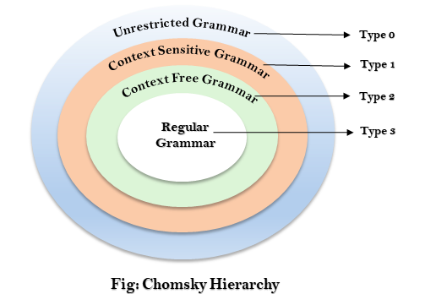
Cont…
Every language of type 3 is also of type 2, 1 and 0. Similarly, every language of type 2 is also of type 1 and type 0, etc.

Slide 11
Cont…
LHS X --> Y RHS
T (0) : At least one variable at LHS
  aA → aBas
  A→aBaS
T (1) : T (0) + | X| <= | Y|
  aA→bb
  aBa→ abab
T(2) = T (0) + T (1) + | X| =1
  S→aba
T(3)= T(0)+T(1)+T(2)+ Y
Y belongs to VT* + T* OR T*V+T*
  S→Baaa
  S→aaaaA

Slide 12
Cont…
Type 0 Grammar:
Type 0 grammar is known as Unrestricted grammar. There is no restriction on the grammar rules of these types of languages. These languages can be efficiently modeled by Turing machines.
bAa → aa
S → s

Slide 13
Cont…
Type 1 grammar is known as Context Sensitive Grammar. The context sensitive grammar is used to represent context sensitive language. The context sensitive grammar follows the following rules:
The context sensitive grammar may have more than one symbol on the left hand side of their production rules.
The number of symbols on the left-hand side must not exceed the number of symbols on the right-hand side.
The rule of the form A → ε is not allowed unless A is a start symbol. It does not occur on the right-hand side of any rule.
The Type 1 grammar should be Type 0. In type 1, Production is in the form of V → T

Slide 14
Cont…
S → AT
T → xy
A → a

Slide 15
Cont…
Type 2 Grammar is known as Context Free Grammar. Context free languages are the languages which can be represented by the context free grammar (CFG). Type 2 should be type 1. The production rule is of the form
A → α
Where A is any single non-terminal and is any combination of terminals and non-terminals.

Slide 16
Cont…
A → aBb
A → b
B → a

Slide 17
Cont…
Type 3 Grammar:
Type 3 Grammar is known as Regular Grammar. Regular languages are those languages which can be described using regular expressions. These languages can be modeled by NFA or DFA.
Type 3 is most restricted form of grammar. The Type 3 grammar should be Type 2 and Type 1. Type 3 should be in the form of V → T*V / T*
Example: A → xy

Slide 18
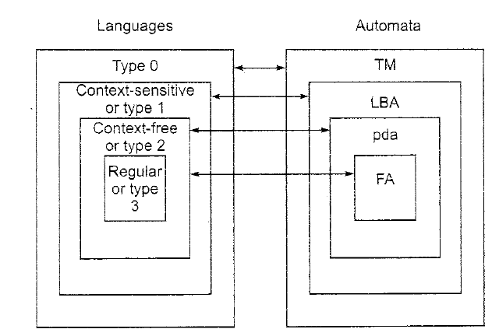
LANGUAGES AND AUTOMATON
Notes:
The Chomsky Hierarchy

Slide 19
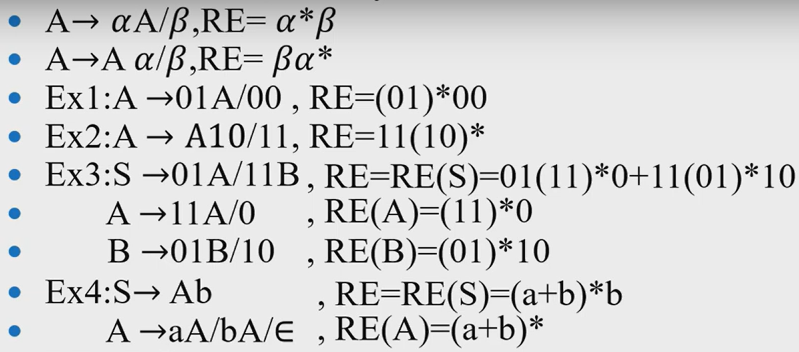
Regular Grammar to Regular Expression

Slide 20
Regular Grammar to Regular Expression

Slide 21
Regular Grammar to Regular Expression

Slide 22
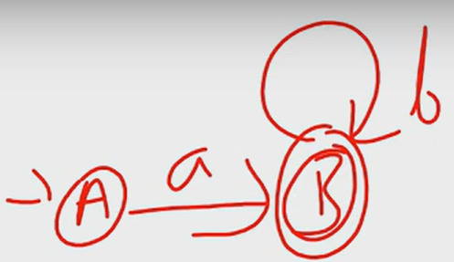
Regular Expression to Regular Grammar
Important Points:
RLG: Start symbol is initial state and Epsilon transition will be in final state, considers outdegree
LLG: Start symbol is Final state and Epsilon transition will be in initial state, considers indegree

Slide 23
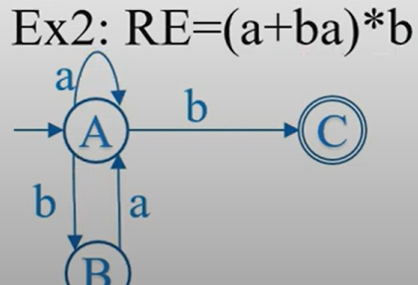
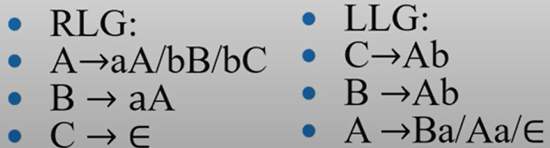
Regular Expression to Regular Grammar

Slide 24
Cont…

